Slide 1
High Load System DB
Database problems and some ways to solve them

Slide 2
Introduction about me
Hello I am Maris Ločmelis
I am full stack developer so don't hit me hard when I miss something.

Slide 3
What types of DB are there.
SQL, NoSQL, In Memory (redis), SingleFileDB(XML, JSON) ...
ask chat GPT he will help here.

Slide 4
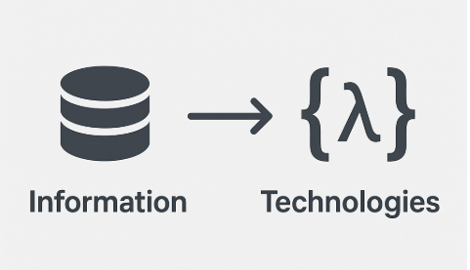

How High Load is related to Database ?
Development is IT (Information Technologies) So DB is main part of industry as it stores Information,
and you can't have high load system without information (it will be high waste system).

Slide 5
More useful info about DB types
ACID vs BASE ACID (traditional SQL databases) Ensures strong consistency and reliability:
(A)tomicity + (C)onsistency + (I)solation + (D)urability
Used by: MySQL, PostgreSQL, Oracle, SQL Server, etc.
BASE (mostly NoSQL / distributed systems) Designed for horizontal scaling and high availability:
(B)asically + (A)vailable + (S)oft-state + (E)ventually consistent
Used by: Cassandra, DynamoDB, Riak, Couchbase, etc.

Slide 6
Key Problems
1. Hard Drives can give a heat (bad sectors // no time to write // during backups) right now not so huge problem due SSD.
2. Master Slave Replication things (Primary Keys (Long, Int, UUID), scaling data sync).
3. Deadlocks on huge request amount.
4. Cache Memory outage.
5. Temporary tables.
6. Complex Joins
8. Wrong field data types.

Slide 7
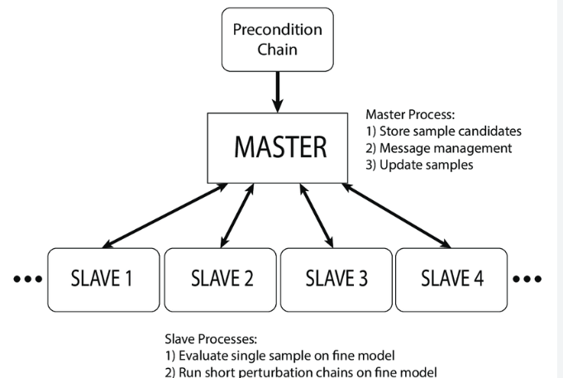
Master Slave

Slide 8
Index problems
Indexes takes time to save and can flood your cache (it may result as deadlocks)
Indexes should be sorted.
Huge indexes.

Slide 9
MySQL data structure, potentially all are similar
Usually primary take away and what you should understand picking technology is how DB stores the data I will explain on MySQL example (Other SQL DB like PostgreSQL or Oracle looks similar with some other functions but most will be covered as same.)

Slide 10
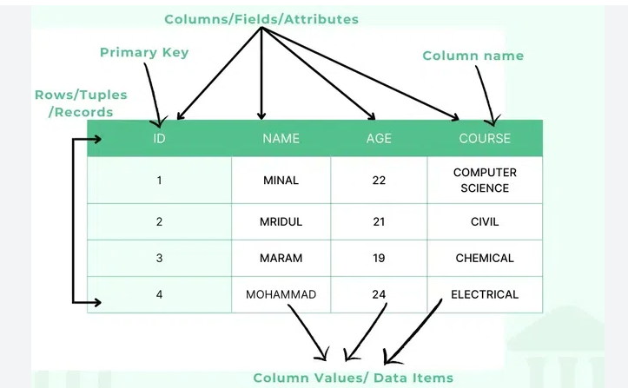
MySQL data structure.
you describe fields (each field have type and limits on containing value)

Slide 11
MySQL data structure.
Each row reserves maximum field size on HD even if they are null (to jump between rows based on pure math)
Text Fields are storing Pointer to data that besides out of table (it is optimal but will slow down on filtering texts)
Data is pure math the more Bytes it takes the more time it makes for all operations

Slide 12
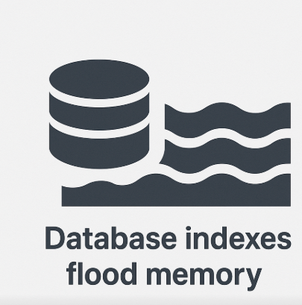
Indexes
Indexes takes time to save and can flood your cache (it may result as deadlocks)
Indexes should be sorted.

Slide 13
Useful Functions for debugging.
SQL usually have multiple ways to debug the application I may not name all but I will touch best ones.
1. Explain Analyze (Query here)
2. SHOW PROCESSLIST.
3. slow_query_log = 1 // best to log all queries (5-10 minutes) than group analyze total execution time
4. KILL PROCESSID (to identify deadlock parent usually oldest one but not always.)
5. Usually low resources can lead to deadlocks (waiting for cache to get free. so resource analyze like top can be good also)

Slide 14

How you could optimize something ?
1. Most common and probably best hotfix is caching results and resetting on change
2. Templates
3. Create Agregation tables on complex grouping logic tables (Full Table Scan)
4. Insertion (Batches. Transactions.)

Slide 15
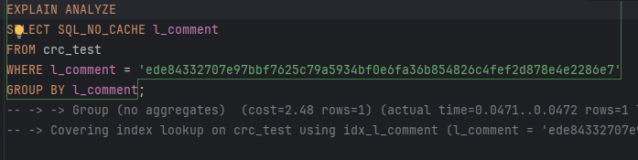
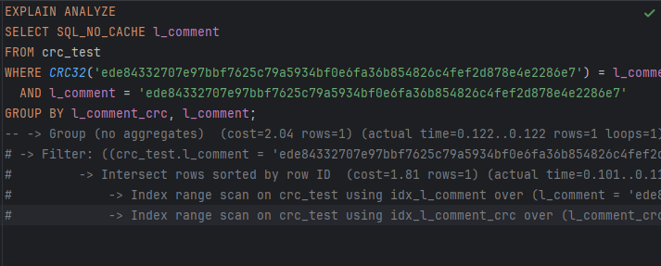
CRC32 string // text Optimization

Slide 16
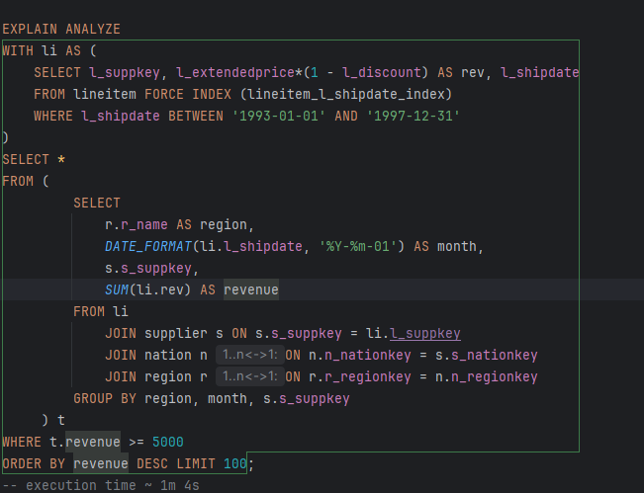
Slow Query

Slide 17
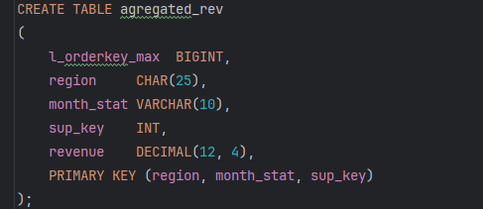
Create Agregate Table

Slide 18
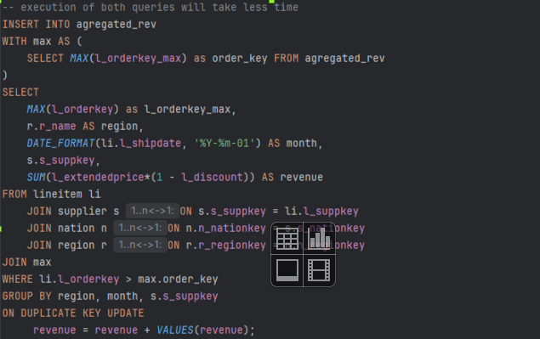
Insert missing data to agrigate Table

Slide 19
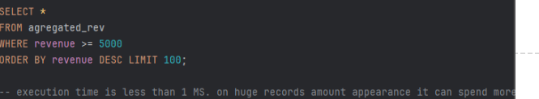
Last Query

Slide 20
What is Large DB ?
* small DB < 1 GB
* 1 GB > average DB < 1 TB
* 1 TB > Big DB < ... (it hard but there is point when it comes to huge)

Slide 21

What you should expect and do
Small DB. Anything should work fine
Average DB. Don’t be fanatic with group logic add master slaves
Large DB. Partitions, optimizations like CRC32 agregation tables
Huge DB. Hire Senior DB architect and hope he will do something.

Slide 22

Partition
Group table by data (each month in separated partition // table)
Don’t intersect partitions data (only statistic summaries)
Always pick option with balanced data amount
Use CRC32 (first n symbols) on any field if you have nothing in mind

Slide 23
Additional Options
* Schedulers – runs procedure at specified interval // time
* Procedure – executes Queries without result in single transaction
* Function – Same as procedure but will return result.
* wouldn’t recommend to do many of them. They are hard to debug and can lead to huge deadlocks. Also developers may have magic.

Slide 24
Best to evade ?
* Huge table better to not use DROP TABLE or ALTER TABLE
* You can create new table sync it with prev then swap tables with Rename.
* If you will swap pick right order and check on non prod envs.
* migrate existing data after rename (there will be data and time gap can even be big so migrate 1 or 2 weeks is good choice)

Slide 25

Is there any risks on rename ?
* during rename there will be moment when there won’t be table.
* You can stop production tables.
* You can make logic first working for both cases then rename without risk.

Slide 26



What to do for optimization ?
better to just grow structure of tables.

Slide 27
What you should know about complex queries.
There are tons of grouping functions like, AI may help with finding right approaches for your case
With
Union
GROUP BY
Distinct

Slide 28
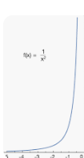
Something Useful about table data grouping
* DISTINCT - where possible
* GROUP_CONCAT – evade
* ORDER BY – only if needed.
* Newer skip limiting

Slide 29
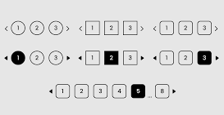
Limiting the query results is important!
* use always limits on large tables
* low records with limits have no harm, huge tables limits saves production
* Pagination is best friend
* There are optimizations on page navigations for large tables.

Slide 30
Thanks, for Your time hope You found something useful
PS if you would like to get deep drive in any of sections you can write them down on paper and drop in box.
Training Materials > https://github.com/Neznajki/devclub-high-load-db
If You have questions >
https://www.linkedin.com/in/ml-698627181/
dev@maris-locmelis.lv

